Slide 1


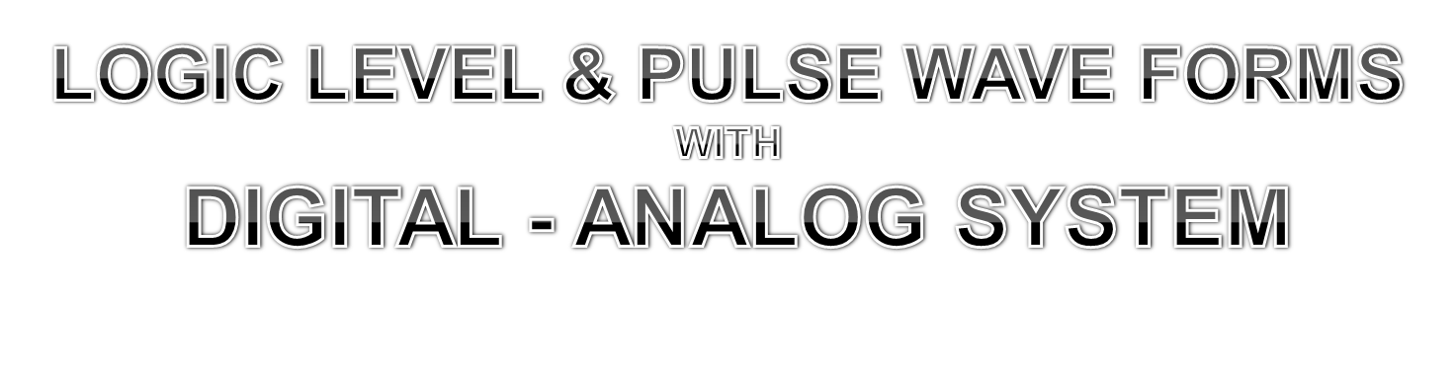
B.C.A COLLEGE
COMPUTER ORGANIZATION

Slide 2

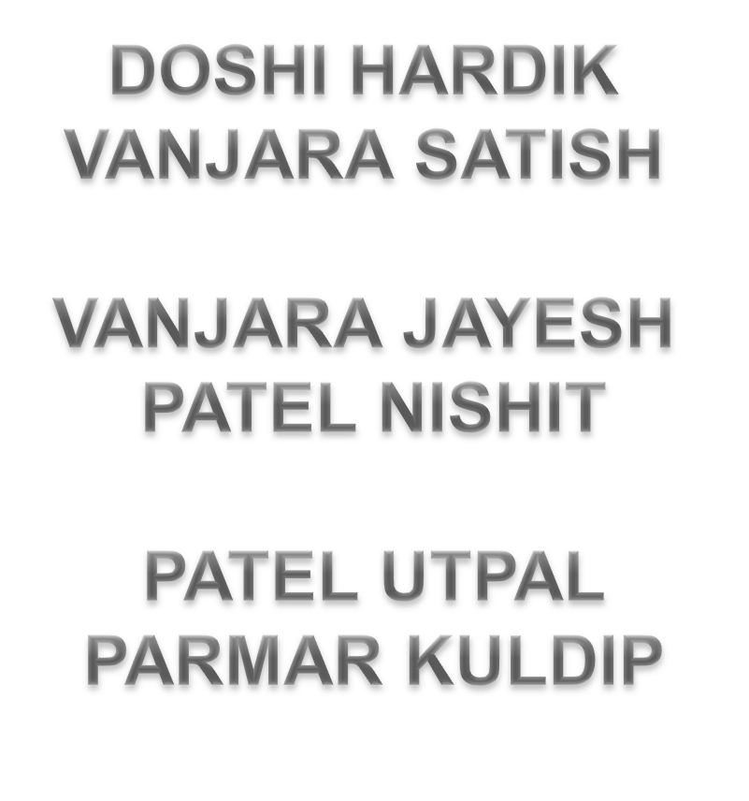

Slide 3

LOGICAL LEVEL CAN BE BASED ON TWO BINARY FORM 0 & 1
BOTH ARE KNOWN AS POSITIVE AND NEGATIVE VOLTAGES.
WHERE 0 STANDS ON NEGATIVE VOLTAGE & 1 STANDS FOR POSITIVE VOLTAGE .
LOGIC LEVEL ARE USED FOR DECISION MAKING IN 0 AND 1
EX:- BOOLEAN DATA
GENERALLY LOGIC LEVEL ARE USED IN DIGITAL SYSTEM
ONE VOLTAGE CYCLE 0 TO 1 AND THAN AGAIN TO 0 CREATES ONE PULSE

Slide 4


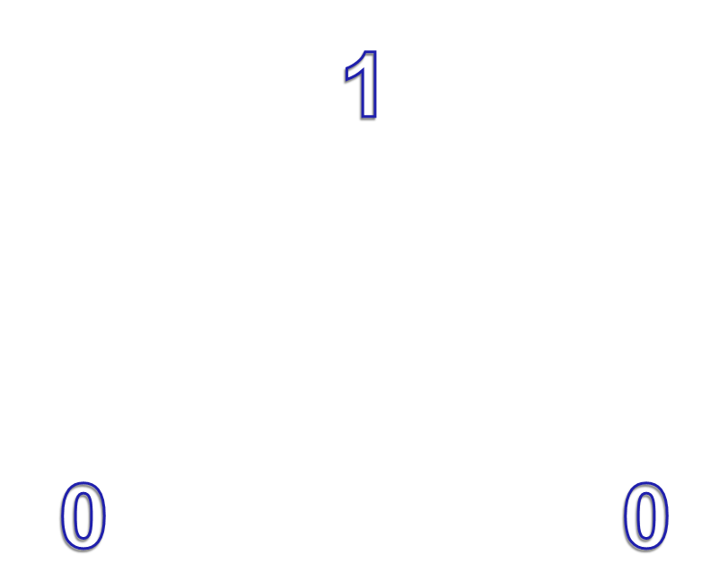

Slide 5

PULSE IS GENERATED WHEN ONE VOLTAGE GOES TO ITS OPPOSITE SIDE AND BACK RETURN TO ITS MAIN FORM
THERE ARE TWO TYPE OF PULSE WAVE …
1 > POSITIVE PULSE WAVE ..
2 > NEGATIVE PULSE WAVE..

Slide 6
1 > POSITIVE PULSE WAVE ..
..STARTS FORM NEGATIVE AND GOES TO POSITIVE THAN BACK TO ..NEGATIVE FORM IS CALLED ONE POSITIVE PULSE & MORE THEN ONE PULSE CREATE PULSE WAVE..

Slide 7



LEADING EDGE
TRAILING EDGE

Slide 8
2 > NEGATIVE PULSE WAVE ..
..START FROM POSITIVE & GOES TO NEGATIVE AND BACK TWO POSITIVE FORM IS CALLED NEGATIVE FORM WAY

Slide 9


LEADING EDGE
TRAILING EDGE

Slide 10
INTRODUCTION
Through the time we have seen many technologies. Some are analog & some are digital. The main difference between analog and digital is that, in digital technology, the analog wave turn into numbers that are stored in the digital device.
Ex.- Data on cd [ compact disk ]
in analog technology, a wave is use in it’s original form.
Ex.- A signal from the microphone

Slide 11

THE TERM DIGITAL MEANS THAT THE SIGNAL IS LIMITED TO ONLY A FEW POSSIBALE VALUES .
IN GENERAL,DIGITAL SIGNAL ARE REPRESENTED BY ONLY TWO POSSIBLE VOLTAGES ON A WIRE 0 VOLTS & 5 VOLTS.
IN DIGITAL ELECTRONIC USES 0 VOLT AS “LOW” OR “FALSE” OR “0” AND 5 VOLT AS “HIGH” OR “TRUE” OR “1” IN DIGITAL COMPUTER, 0 & 1 DIGIT KNOWNAS BITS [ BINARY DIGITS ]

Slide 12









Slide 13

ANALOG ELECTRONICS USES VOLTAGES, CURRENT OR FREQUENCY THAT CAN BE ANY VALUE.
THE VOLTAGES OFTEN CHANGE SMOOTHLY FROM ONE VALUE THE NEXT
EX :- A DIMMER LIGHT SWITCH UP / DOWN.
THE FIGURE BELOW SHOWS AN ANALOG SIGNAL THAT CHANGE WITH TIME

Slide 14




Slide 15

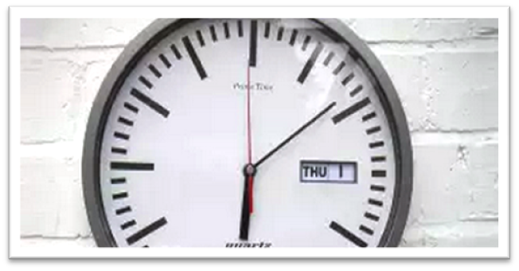
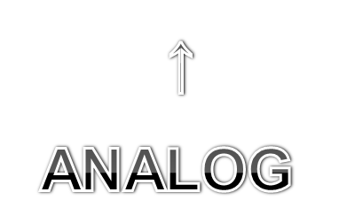
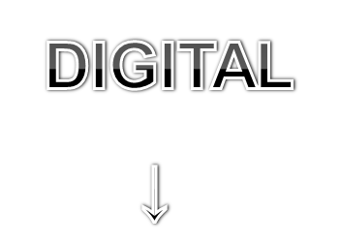
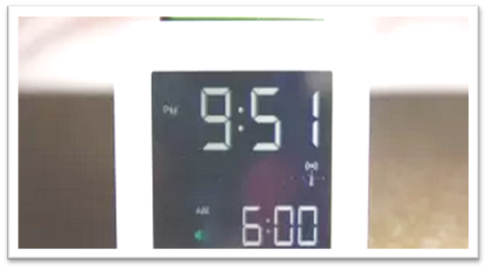

Slide 16
Real Life Example Of Digital & Analog System..

Slide 17



